Slide 1

Managing Moving to Cloud The risks and opportunities of cloud-based accounting information systems
Sai Yawn Lu
Sime B. Sime
Kaustuv Dutta

Slide 2
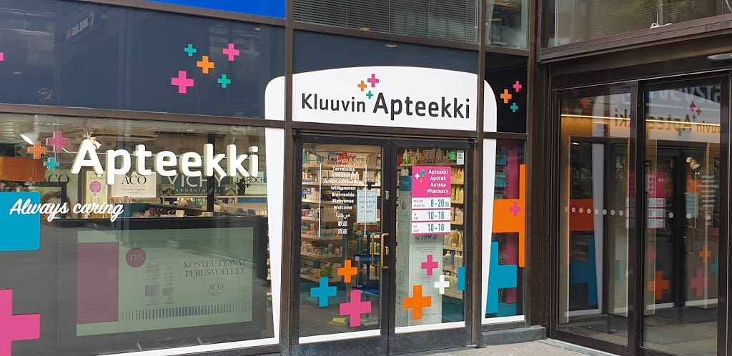
Introduction/Background
Pharmacy company called Kluuvin Apteekki
Privately owned by Pia Moksi
Located in Helsinki, Finland
Four Years old with 2.2 million Euro turnover
Another branch at Merihaka district
419,000 Euro turnover

Slide 3
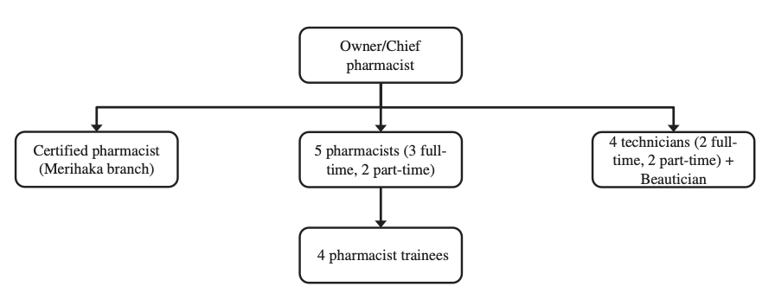
Introduction/Background
Management & Operation
Pia Moksi is in charge of everything
overall management & accounting, bookkeeping
16 Employees – 9 of them part-timers
Pharmacy business strictly regulated and competitive
Innovative to be Competitive
Excellent Customer Service
Add products not regulated such as beauty and personal care
Company Structure

Slide 4
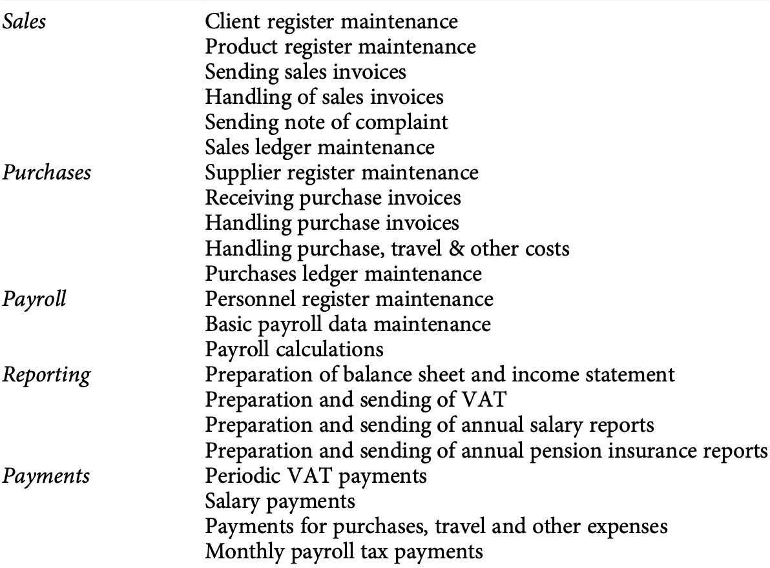
Current AIS System Analysis
Using Excel sheet and inhouse Accounting Systems Software
Five Main Accounting Tasks
Sales, Purchases, Payments, Reporting, Payroll
22 Sub-tasks
680 Outgoing Sales Invoices Annually
Most manually produce and on paper
840 Purchase Invoices annually
92% on paper, and the rest are email and e-invoice
The same number of suppliers and purchases annually

Slide 5
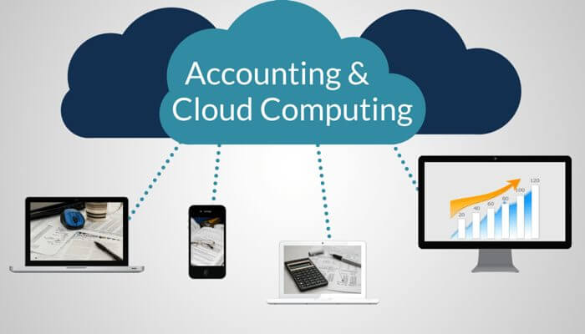
Problems
Taking all Pia's time to do the accounting
No time for strategic company expanding
Outsourcing the Accounting Information Systems (AIS)
Using cloud-base AIS
Migration Doubts
Research done by Pia about cloud-base AIS
Which systems to choose
Trust issue with the cloud-systems
How to do SLA
Need professional guidance

Slide 6
1. Question
For small business like Kluuvin Apteekki, which cloud service is most suitable?

Slide 7
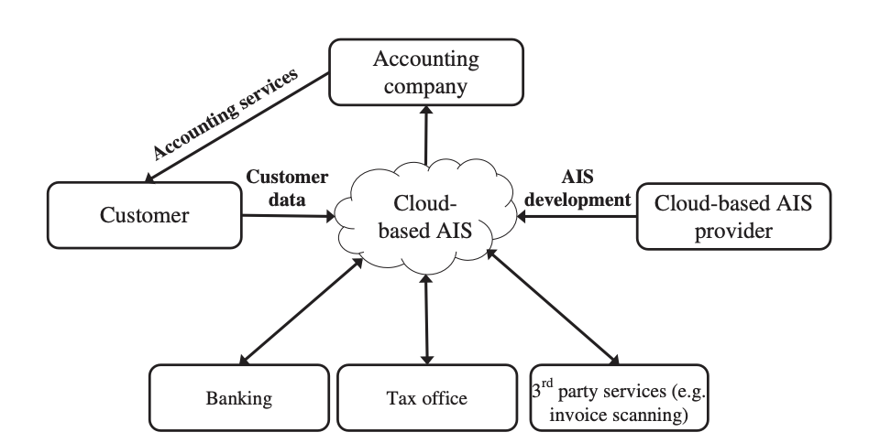
Solutions to Problems
As a consultant, help develop SLA and choose the best AIS for Pia
Software as a Service (SaaS)
Most feasible due to small company
Not all tasks should be move to cloud
Tasks related to purchases should be done in-house due to suppliers unchanged
The important requirement Pia wants
Cloud-base accounting information systems
Migration without fault or no-fault tolerance
Cost effective – must be cheap and efficient
Secure systems esp. for data security

Slide 8
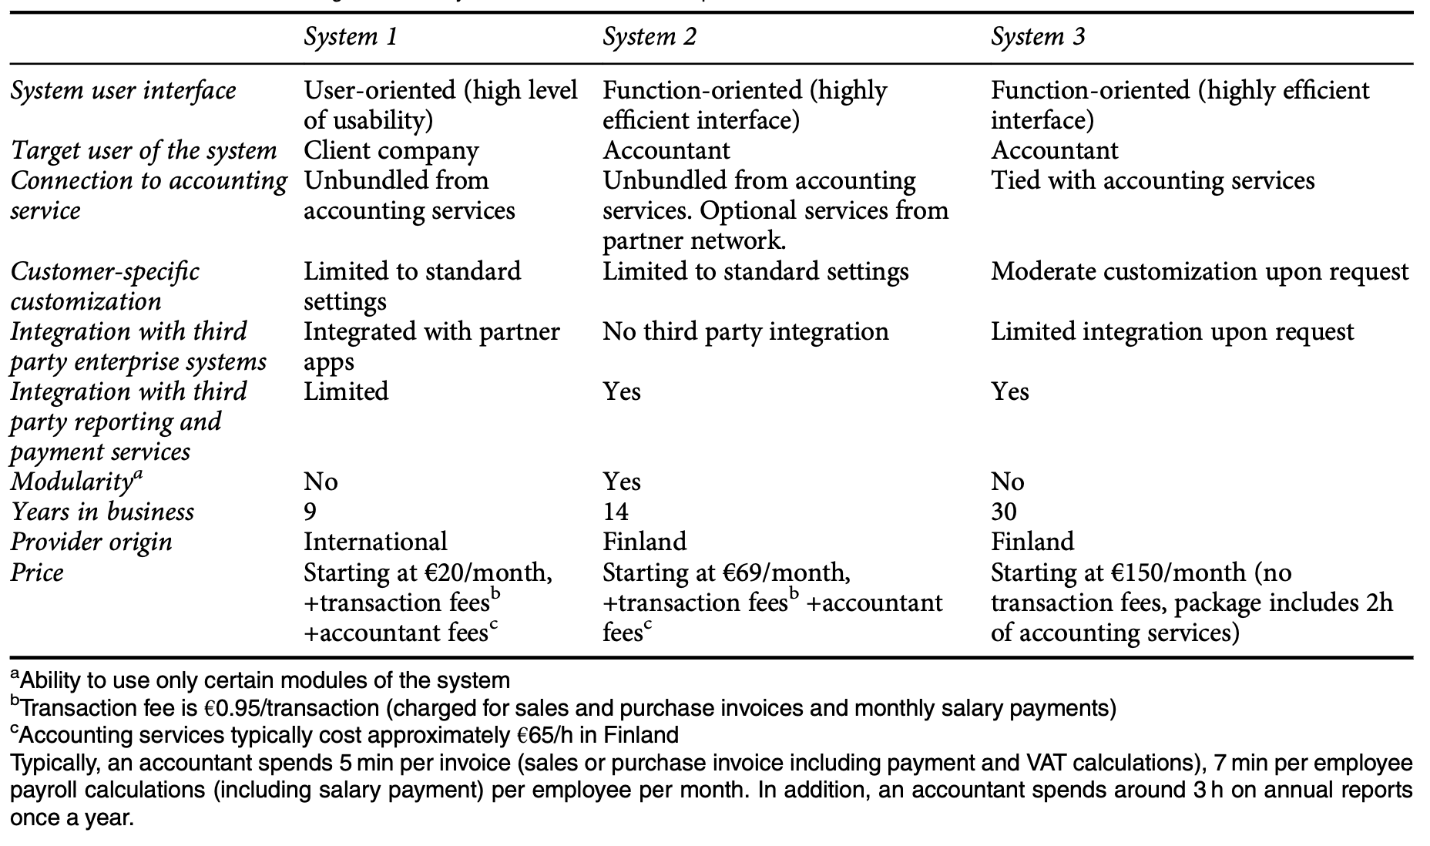
Solutions to Problems
Pia found three systems from her research
Recommend system 3
Based in Finland and compliance
Cost effective
Third party system integration included on demand
No transaction fees, plus 2 hours of accountant time monthly
30 years of experience in the industry
Ensure security
Smooth migration

Slide 9
2. Question
Should Pia be worried about possible lock-in with either accountant or system provider?

Slide 10
Risk Analysis
Asset
Threats
Company full-time and par-time employees
Sensitive accounting data
Systems Specialized for Pharmacy
Local Servers
Servers with non-sensitive data
Web applications
Employee’s workstations
Employee sensitive data
Phishing
Zero-Day Exploits
DDoS
Malware/Ransomware
Hacking of Email Accounts

Slide 11
Risk Analysis
Vulnerability
Control
No mandate for passwords
Unpatched systems
Legacy systems
Weak Passwords
Lack of multi-factor authentication (MFA)
Failure of Intrusion Detection Systems (IDS)
Strict Password Policy
Strict Patching Policy
Encryption (Cryptography)
Stronger Firewalls
Phishing Training Programs (all employees)
Continuous Risk Audit/Analysis
Cyber Security Insurance

Slide 12
Qualitative Risk Analysis (Current AIS)
Threats | Business Impact | Probability of Attack | Cost of Fix | Difficulty to Fix | Risk Level
Malware/ Ransomware | High | High | High | Medium | High
Email Account Hacking | Low | Medium | Low | Low | Low
Phishing | Medium | High | Medium | Low | Medium
DDoS | Low | High | Medium | Low | Low

Slide 13
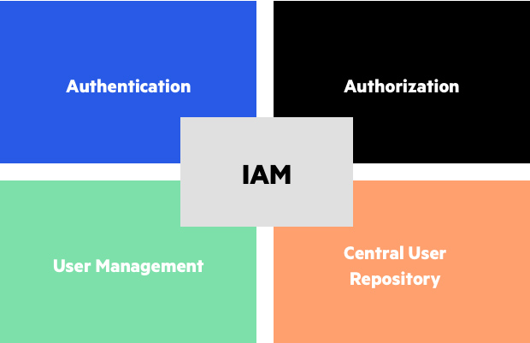
Current Threat
Poor Identity & Access Management
Access management is one of the most common cloud computing security risks. The point of access is the key to everything. That’s why hackers are targeting it so much.
In 2016 LinkedIn experienced a massive breach of user data, including account credentials (approximately 164 million).
The reasons were:
insufficient crisis management
ineffective information campaign
the cunningness of the hackers

Slide 14
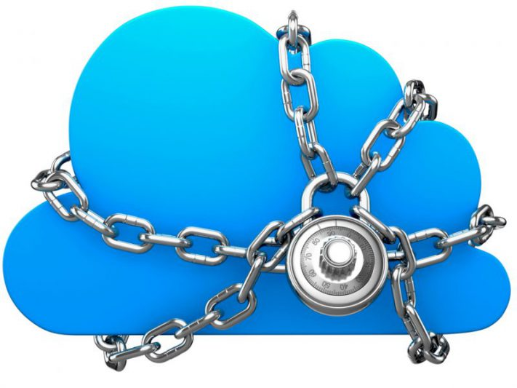
Current Threat
Vendor lock-in associated risk
Application transfer risk
Infrastructure transfer risk
Human resource knowledge risk

Slide 15
Current Threat
Data Breaches
Data breaches are referred to as unauthorized access to sensitive information and occur out of negligence, hacker abuse of insecure API while sharing files, and password and human error by cloud engineers.
The best way to counter data breaches is to set an effective security model which contains multifactor authentication and encryption, which will deny any unauthorized access to sensitive customer, employee, and financial information.

Slide 16
3. Question
How should Pia mitigate the possible data security risks?

Slide 17
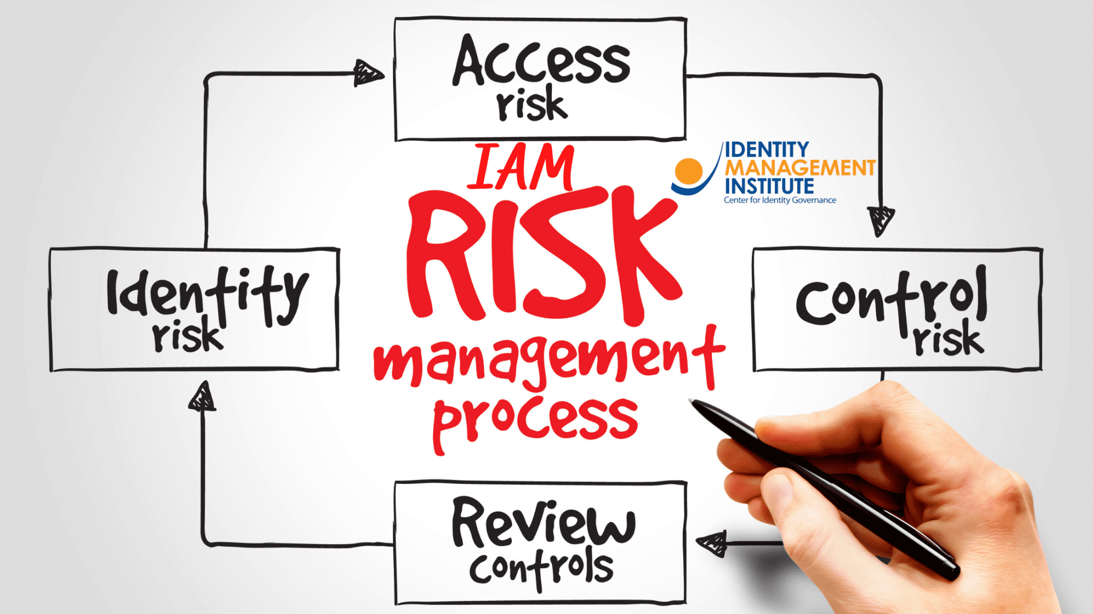
Countermeasure

Slide 18
Conclusion & Recommendations
Based on our case study on Kluuvin Apteekki, the software-as-a-service cloud-based service model is advised for Pia because it will ensure that the service provider will take care of the IT infrastructure and platforms, including the information security. This will end Pia's doubt on the data security issue even though she still needs to ensure that the access level security controls are in place.
We did our research on different accounting tools available on today’s market and we came up with a couple of recommendations that can be beneficial for any small business who are seeking cloud accounting solutions.

Slide 19
Conclusion & Recommendations
The cloud-based accounting program QuickBooks Online was created with small businesses, independent contractors, start-ups, and bookkeepers in mind. Because of the sophisticated and well-recognized security measures used by this program, Pia can always be sure that her accounting data is safe. Pia may work with her accountant and other stakeholders in the cloud, view and manage your financial data from any device at any time.
For new microbusinesses and independent contractors, the monthly cost of QuickBooks is $8. The next tier is $12 per month for three users plus an accountant and is designed for expanding enterprises. The cost is feasible considering a small farm like Kluuvin Apteekki.
You may access QuickBooks Online from any device, at any time, because it is entirely web-based. Using your smartphone, you may create reports or perform a quick cash flow check. This is something hugely convenient for someone like Pia who wants to access her resources from anywhere.

Slide 20
Q & A

